Slide 1



DataSage
Unlocking the power of unstructured data for enhanced AI response quality

Slide 2


Welcome to DataSage!

Slide 3


Inefficiencies in Current Chunking Methods
Existing methods fail to effectively segment unstructured data.

Slide 4


DataSage: Intelligent Segmentation for AI
Utilizing Azure Document Intelligence and OpenAI embeddings for enhanced data handling.

Slide 5



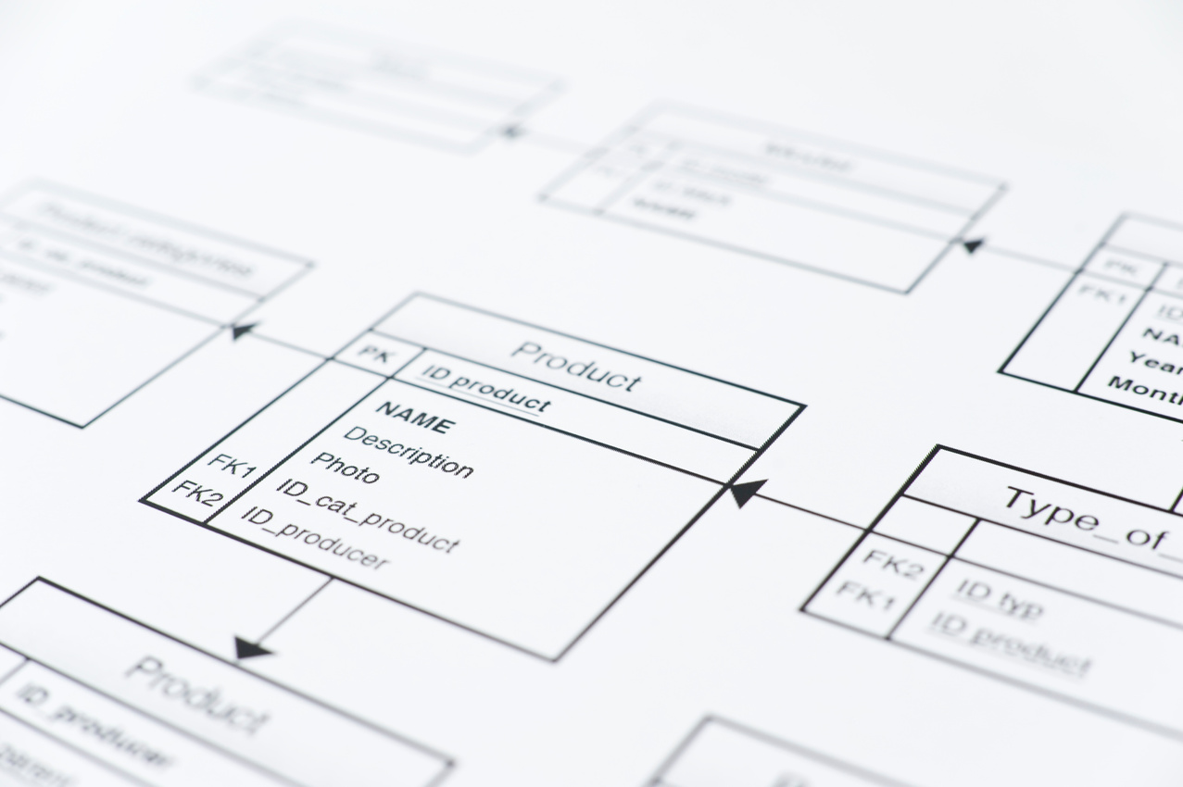
Embedding and Storing Data Chunks
Embedding Process
Storing in Vector Database
DataSage converts unstructured data into meaningful chunks for AI.
Chunks are efficiently stored in a vector database for fast retrieval.

Slide 6


Retrieval and Response Workflow
Data Retrieval Process
Response Generation Techniques
The process involves pulling relevant data chunks from a vector database.
Utilizing embeddings to generate coherent and context-aware responses from retrieved data.

Slide 7



Automated Evaluation and Optimization
DataSage enhances performance through continuous evaluation and optimization techniques.

Slide 8

Benefits and Applications of DataSage
DataSage significantly enhances AI response quality for diverse industries.

Slide 9

Hackathon Prototype Features of DataSage
Introducing our innovative tools for seamless AI integration and enhanced user experience.

Slide 10


“Connecting structure and semantics for superior AI response quality.”
– DataSage Innovation

Slide 11

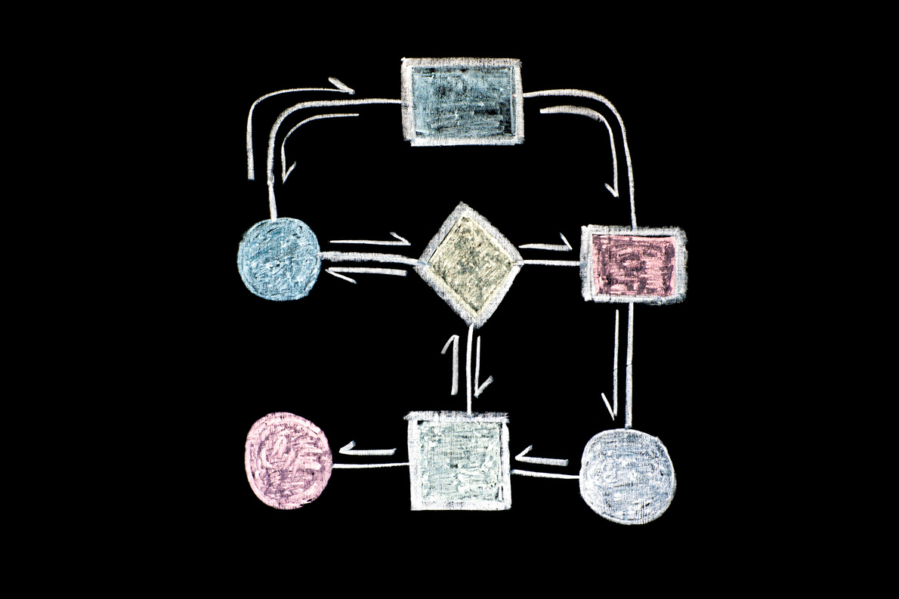
DataSage: Transforming Unstructured Data
Intelligent Segmentation Methods
Enhanced AI Response Quality
DataSage utilizes Azure Document Intelligence for seamless data chunking.
Our approach connects structure and semantics to improve AI outputs.

Slide 12


The team behind DataSage
Arthur Duarte
Izabelly Armeris

Slide 13
Thank you!

